Slide 1
VLSI DESIGN
Lecture 6
B.E (ECE) 5th semester

Slide 2
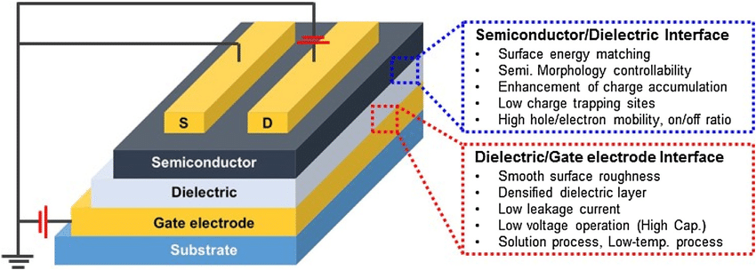
Growth and Deposition of Dielectric Films
In semiconductor processing, dielectric films are essentially used for following purposes:
Parts of the active device, for example, gate oxide of a MOS transistor.
(The gate oxide is the dielectric layer that separates the gate terminal of a MOSFET (metal-oxide-semiconductor field-effect transistor) from the underlying source and drain terminals as well as the conductive channel that connects source and drain when the transistor is turned on.)

Slide 3
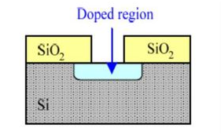
Used as masks to protect against diffusion or ion implantation.
Used as protecting layer at the end of device fabrication so as to protect from harsh ambience and ensure reliable operation.

Slide 4
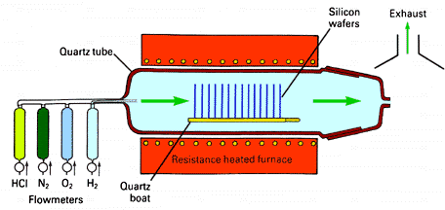
Thermal Oxidation
The oxygen is led to the wafers in gaseous state and reacts at the wafer surface to form silicon dioxide. Depending on the gases different oxidations occur (a thermal oxidation has to take place on a bare silicon surface).

Slide 5
Thermal Oxidation Methods:
Dry oxidation
The oxidation takes place under pure oxygen atmosphere. The silicon and oxide react to form silicon dioxide:
Si + O₂→SiO₂
This process is done at 1000 to 1200 °C actually. To create a very thin and stable oxide the process can be done at even lower temperatures of about 800 °C.
Characteristic of the dry oxidation:
slow growth of oxide
high density
high breakdown voltage

Slide 6
Wet oxidation
In wet thermal oxidation, the oxygen is led through a bubbler vessel filled with heated water (about 95 °C), so that in addition to oxygen water is present in the quartz tube as steam. The oxidation is given by:
Si + 2H₂O→SiO₂ + 2H₂
This process is done by 900 to 1000 °C.
Characteristics of wet thermal oxidation:
fast growth even on low temperatures
less quality than dry oxides

Slide 7
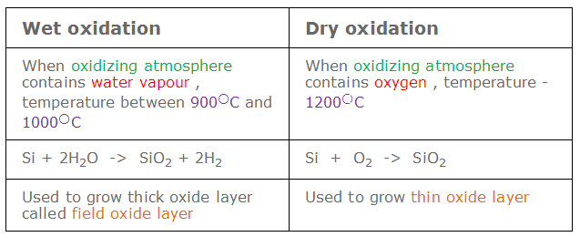

Slide 8
In the beginning, the oxygen and silicon react to form silicon dioxide. Now the oxide layer at the surface has to be surpassed by other oxygen atoms which have to diffuse through the dioxide layer to react with the silicon crystal beneath. For this reason the growth rate primarily depends on the reaction time of oxygen and silicon, while at a certain thickness the oxidation rate is mainly determined by the velocity of diffusion of the oxygen through the silicon dioxide. With increasing thickness of the dioxide the growth rate decreases.
Since the layer is amorphous, not all bonds in the silicon dioxide are intact. Partial there are dangling bonds (free electrons and holes) at the interface of silicon and SiO₂, and therefore there is a slightly positively charged zone at the interface. Since this charges affect the integrated circuit in a negative manner, one tries to reduce this charges. This can be done with a higher temperature during oxidation or by using the wet oxidation which causes only a light charge.

Slide 9
Deposition of Dielectric films
Deposition is a broad term used in semiconductor processing that refers to the layering of additional material on the wafer surface. A reaction between the source gases and the wafer occurs, thereby depositing the desired layer.
PVD involves vacuum deposition processes in which one or more of the depositing species are evaporated or otherwise atomized from a solid source in the coating chamber.
CVD involves deposition processes in which the depositing species are inlet into the coating chamber in a gaseous or vapor form.
Chemical Vapor Deposition (CVD) is a process in which the substrate is exposed to one or more volatile precursors, which react and/or decompose on the substrate surface to produce the desired thin film deposit.

Slide 10
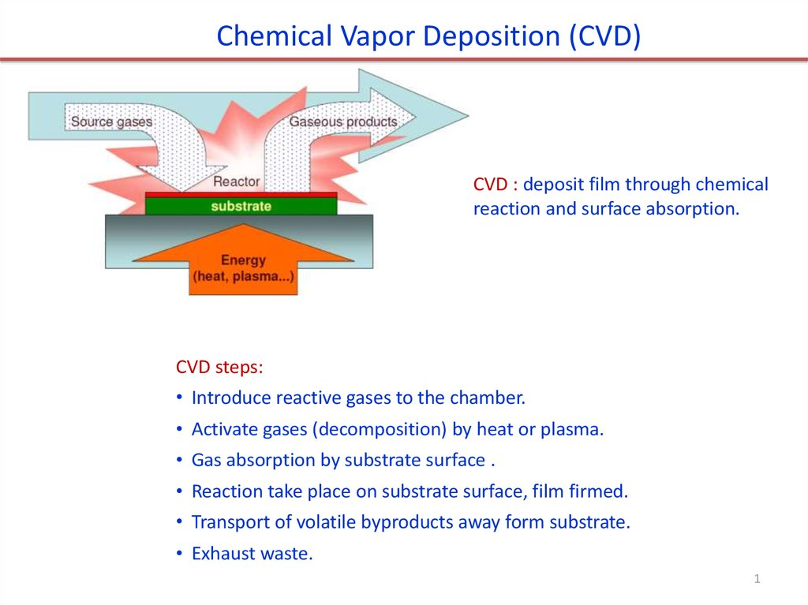

Slide 11
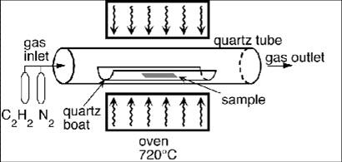
CVD
CVD is a process in which gaseous precursors react to form a solid coating on a heated substrate.

Slide 12
Chemical vapor deposition (CVD) is a vacuum deposition method used to produce high quality, high-performance, solid materials.
The process is often used in the semiconductor industry to produce thin films.
In typical CVD, the wafer (substrate) is exposed to one or more volatile precursors,which react and/or decompose on the substrate surface to produce the desired deposit.
volatile by-products are also produced, which are removed by gas flow through the reaction chamber.

Slide 13
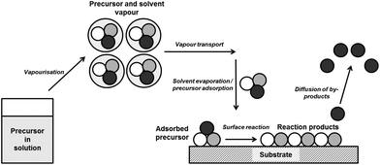
The main steps that occur in a typical CVD process can be summarized as follows :
(1) transport of reacting gaseous species to the surface of a substrate,
(2) adsorption of the species on that surface,
(3) heterogeneous surface reaction catalyzed by the surface of the substrate,
(4) surface diffusion of the species ...

Slide 14
Questions for you...
Illustrate the use of SiO2 in IC fabrication.
Compare thermal oxidation and Chemical vapour deposition techniques.

